Slide 1
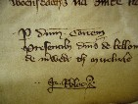
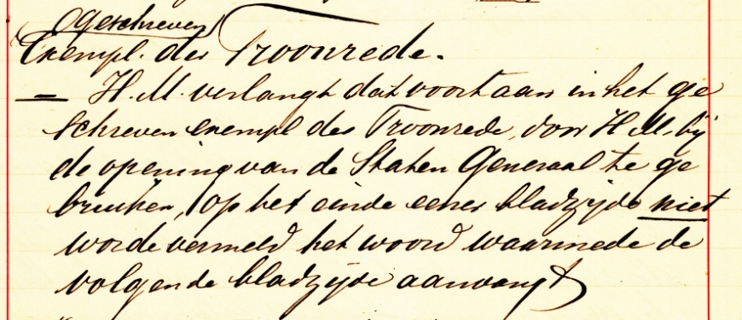
Handwriting Recognition
A comprehensive course with practical assignments
Lambert Schomaker

Slide 2
Overview - 2017
Teachers:
Prof. Lambert Schomaker
Sheng He (postdoc researcher)
Mahya Ameryan (PhD researcher)
Maruf Dhali (PhD researcher)
Goal
What is handwriting recognition?
Course setup

Slide 3
Goals of the course
Challenge you on several levels:
Learn a scientific approach to pattern recognition;
Develop your skills
in programming for AI
in empirical evaluation of systems
in team work
in scientific reporting (oral/written)
Content area: the elusive problem of computer-based handwriting recognition

Slide 4
What is handwriting recognition?
The automatic translation from written shapes into letter codes

Slide 5
What is handwriting recognition?
The automatic translation from written shapes into letter codes
letter codes: ASCII and Unicode,
which can be used by the computer for
processing (editing, search)
But the end-user’s view may be:
“HWR cleans up my sloppy handwriting”

Slide 6
What is handwriting recognition?
The automatic translation from written shapes into letter codes
What are written shapes?

Slide 7
What are written shapes?
On-Line Recognition: temporal data, the input consists of a sequence of x,y coordinates (a vectorical representation) of the pen-tip movement
A digitizer tablet is used for recording
Off-line Recognition: static data, the input consists of an image of script (a pixel representation).
A scanner is user for recording the script
Often named ‘OCR’: optical character recognition (but in handwriting not always character based!)

Slide 8
What are written shapes?
On-Line Recognition: x_{t},y_{t}, and z_{t} or p_{t}
Off-line Recognition: I(x,y) where the image is Black/white: 1 bit/pixel Grey: 8bits/pixel ➔ lately: 16bits/pixel Color: 3x 8bits/pixel (rgb) ➔ lately: 3x 10bits/pixel

Slide 9
Course setup 2017
Total system
From pixels to words
From word images to character boxes
Preprocessing and Segmentation
Feature extraction
Classification
Tree-based, HMM, CNN or LSTM character search
➔ teams?!

Slide 10
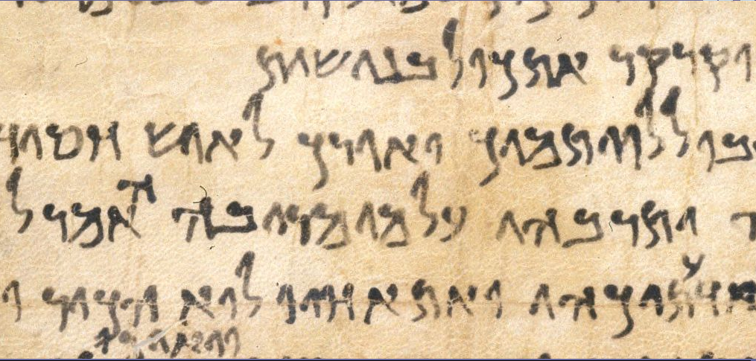
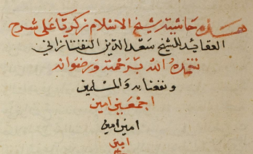
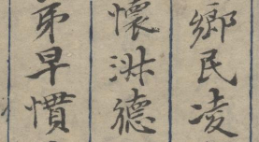
Large-scale processing of handwritten historical documents: The Monk sysem
Lambert Schomaker
ERC project Qumran/Popovic (12-4-2015, Jerusalem)
Academie der Wissenschaften, Mainz, April 2016

Slide 11
Monk e-Science web service addressing these questions:
What? Word retrieval by 24/7 machine learning
Ambition: A European Google for handwriting
When? Medieval manuscript dating Where? Geographical localization
Goal: uploading of charters from 1300-1550 on a server
Who? Writer identification
On Monk server over internet
Using GIWIS Windows tool

Slide 12
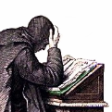



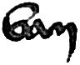

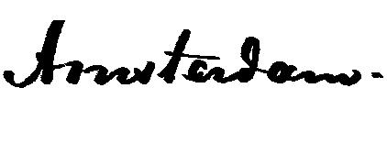

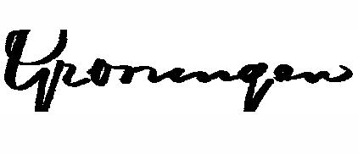


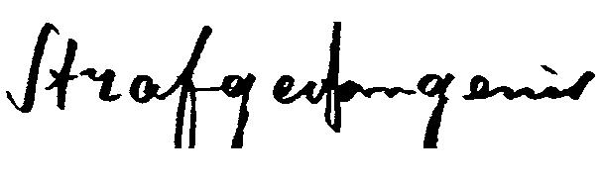



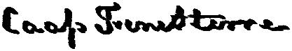
Monk
What?

Slide 13
When? Medieval Paleographical Scale (MPS) with prof. Jan Burgers (paleographer, Huygens Inst.)
PhD student Sheng He
1400
1450
1500
1550
1600
year →
Reference documents
Sub styles, geographical regions
Find year
?

Slide 14
When? Qumran ERC project with Mladen Popovic
Dual-mode time axis estimation (PhD: Maruf Dhali)
C₁₄ estimates
Date & ‘hand’ knowledge
400BCE
350BCE
300BCE
250BCE
200BCE
Reference documents
AnnotationTitle Year
Hand
Region
Paper type
Pen type
Image ROI
C14 estimate
Shape evidence, pattern recognition
Find nearest neighbour
?

Slide 15
Where? Medieval Paleographical Scale (MPS) with prof. Jan Burgers (paleographer, Huygens Inst.)
1400
1450
1500
1550
1600
year →
Reference documents
Sub styles, geographical regions
Find city
?

Slide 16
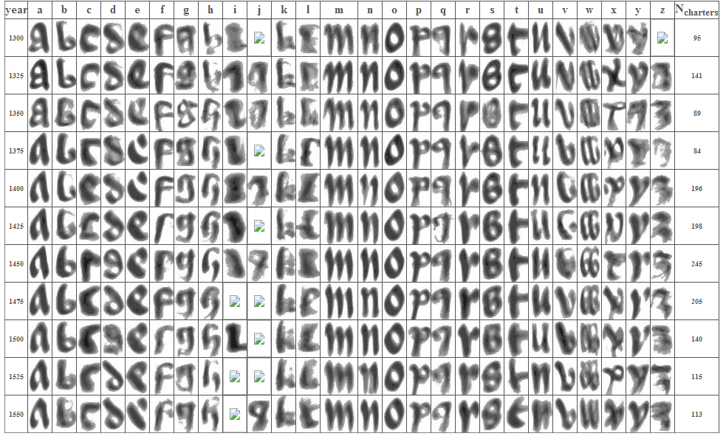
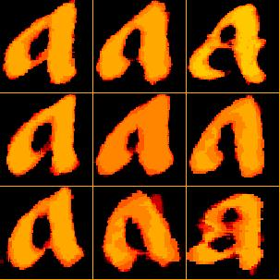
Medieval Paleographic Scale (under dev.)

Slide 17
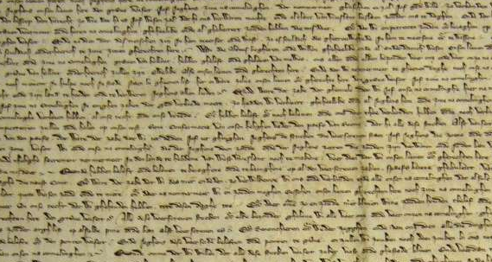
Writer identification (1:N)
and verification (1:1)
1. Interactive,
2. Automatic, ROI based
3. OCR based
fully manual
Who?
Region Of Interest

Slide 18
Researchers & Monk
Marius Bulacu, Axel Brink, Katrin Franke
Ralph Niels, Louis Vuurpijl, Jean-Paul van Oosten, Sheng He, Jan Burgers, Petros Samara, Olarik Surinta
“The Nijmegen Handwriting Group 1984-1993”
Netherlands Forensic Institute: Ton Broeders, Wil Fagel, Elisa van den Heuvel
Isabelle Guyon, Rejean Plamondon
2016: Maruf Dhali, Mahya Ameryan, Sukalpa Chanda
Users (humanities researchers):
Jinna Smit, Mark Aussems, Masahiro Niitsuma, Mladen Popovic, Daniel Stoekl, Jetze Touber, Grace Fong, Elaine Treharne, Dominique Stutzmann, Andreas Weber, Maxim Romanov, many others

Slide 19
Overview
OCR
vs Text retrieval
Monk system: continuous learning
Materials / Collections
Some examples of training
Conclusions

Slide 20
Case: Optical Character Recognition
“The process of segmenting a text image into individual images and classifying each as being a letter in an alphabet”
Impressive results on contemporary printed text in machine fonts: with some linguistic postprocessing results are close to 100%
Solved?
c
h
a
r
a
c
t
e
r

Slide 21
OCR ?
‘OCR’ on historic documents does not work well
On handwritten manuscripts it doesn’t work, at all!
Problems:
image quality
unknown character shapes
unknown statistical language models
However: pattern recognition and machine learning make enormous progress these days!
Which methods? How to apply them?

Slide 22
Current technology: neat text/known language
Why is ‘OCR’, i.e., letter by letter transcription on handwriting so difficult?
Machine print: per character, per font, 8000 training examples are needed, typically
E. Barney-Smith: 200k instances of printed c vs e
Adress reading: reduced lexicon, zip codes etc., help
In linguistic modeling: 20th century newspaper corpora do very little for 15th century acts
Literary text, acts and charters each need their own knowledge models in order for OCR to work

Slide 23
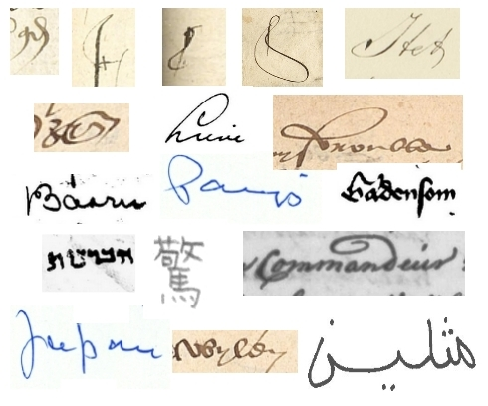
Handwriting recognition: eat this!
Many languages, scripts
Over historical periods
Contractions of letters
‘Suggested’ sloppy letter shapes
Individual writer styles
Image problems
➔ Sliding window for character search usually problematic: exit ‘OCR’

Slide 24
Monk -
Design considerations
Don’t promise perfection
Don’t promise ‘transcription’
Don’t promise exhaustive coverage (as in databases)
Make use of human trainers, volunteers
Word spotting:
“a Google for handwritten documents”

Slide 25
Monk -
Design considerations
Word spotting:
“a Google for handwritten documents”
The word is a reliable chunk of information with many shape features: redundancy minimum
Big Data: With sufficient data, there is always a reasonable response on a query

Slide 26
Monk’s world model:
Institutes
Collections
Books (i.e., documents)
Pages
Paragraphs
Lines
Word zones and characters
Pixels

Slide 27
Functions of Monk from user perspective
Pages (read, annotate)
Lines (read, annotate, search)
Words (cut ROI, labeling, inspect hit lists)
General search functions, ‘google’ over several collections
Human | Machine
Cut out region of interest with the mouse | Segmentation of image into objects
Label a ROI with a text label: | Classify image object
region

Slide 28
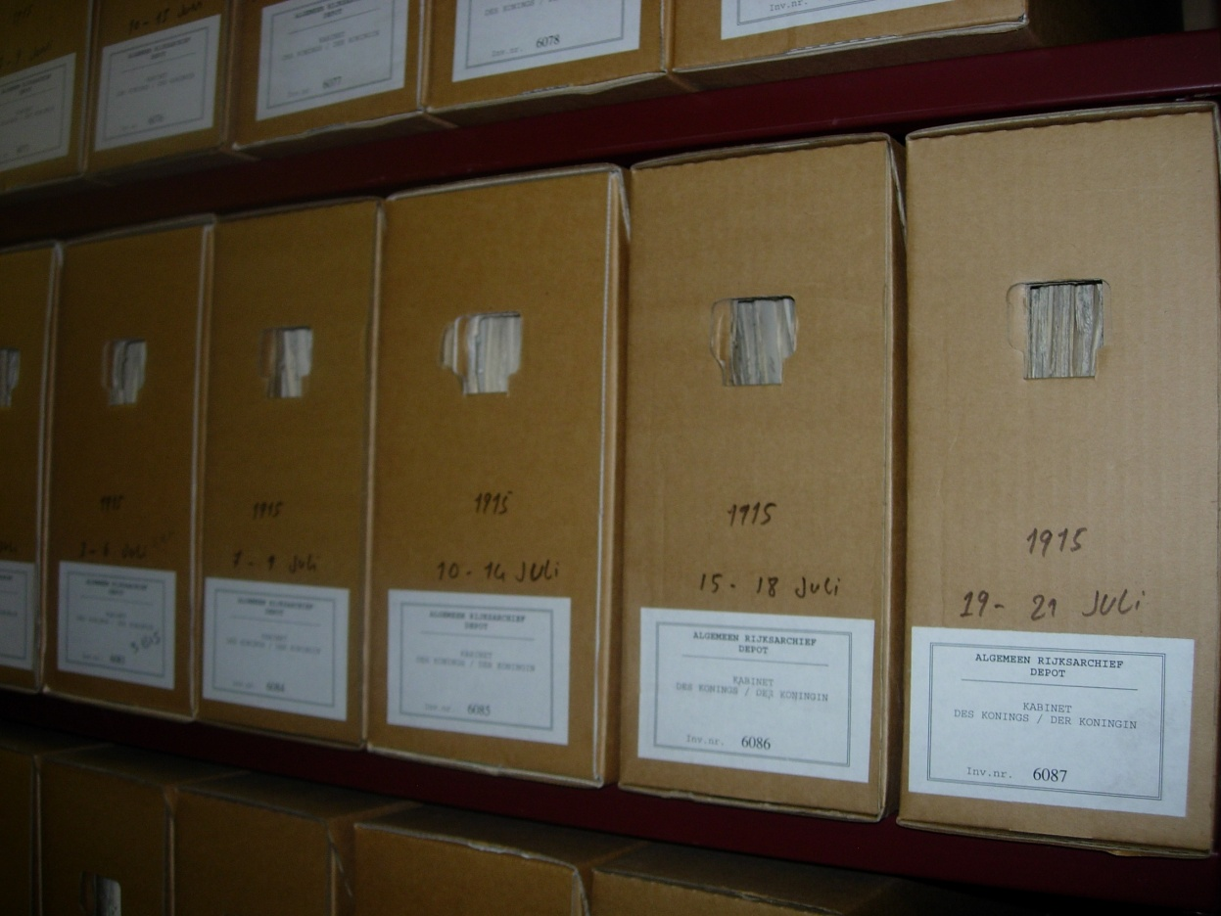
First casus: Cabinet of the Queen (KdK)
all laws, decrees and correspondence are kept:
in a chronological order
and then in a numerical order

Slide 29
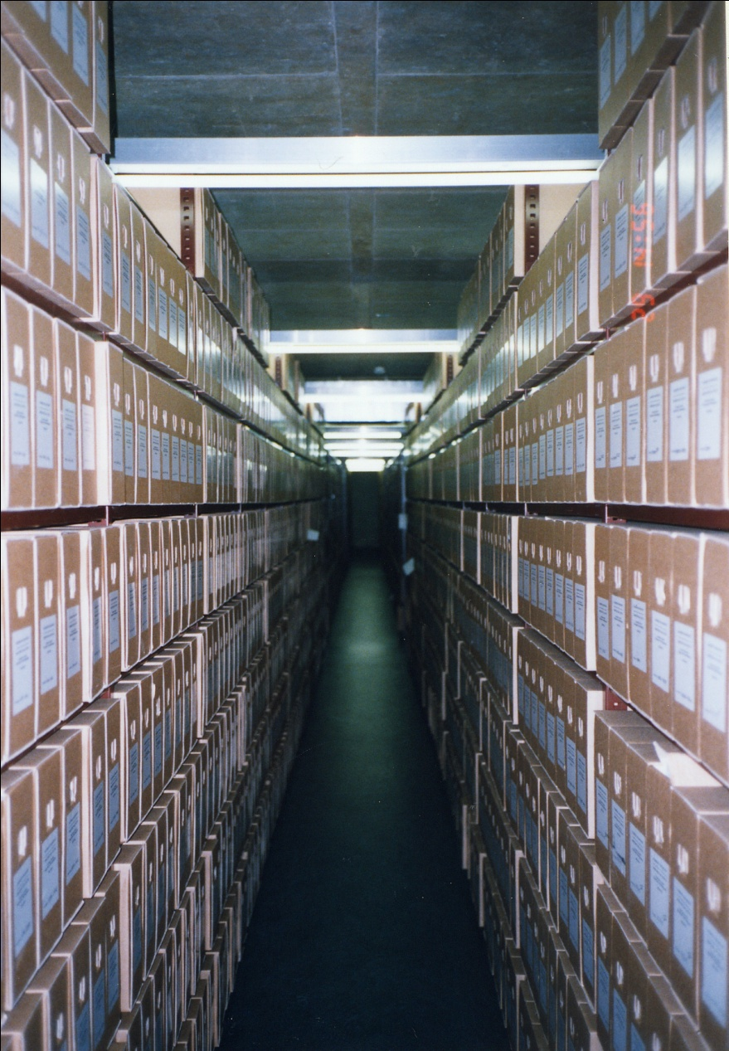
Archival system
KdK Archive with a total extent of
(era 1798-1988):
- 3,250 linear meter of shelves
consisting of:
- 28,000 boxes
average 1,000 pages per box
→ 28,000,000 pages
Of which Monk analyses the handwritten Indices, > 60k pages

Slide 30
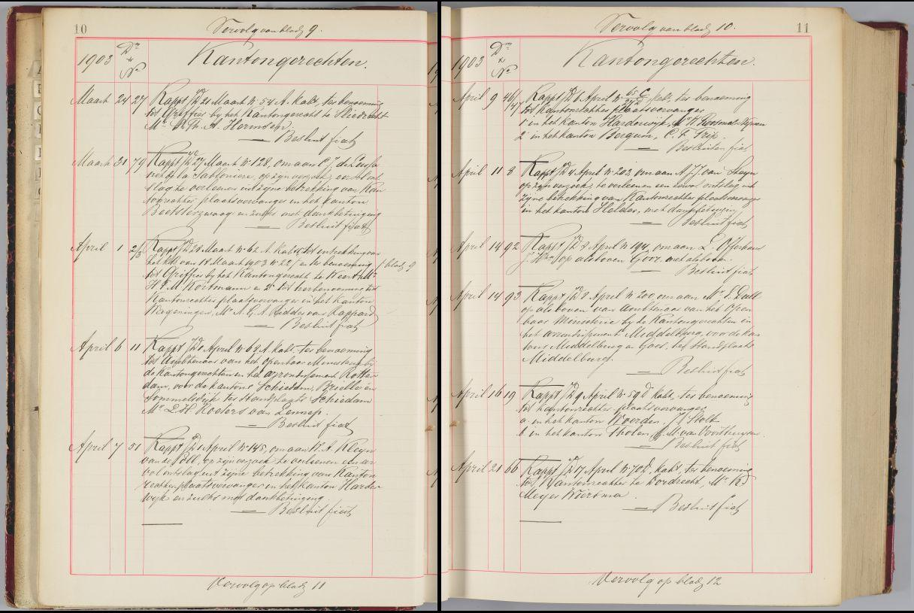
KdK 1903

Slide 31
Coarse overview of current contents Monk, 383 documents, 70k page scans
KdK Dutch administrative 1893-1906 20 books
Dutch Admirality 1760-1823 5 books
Printed, Elzevirium, 1616
Qumran scrolls (2463 scans)
Middelduits (example document)
Accounts, 1425 Gelria
Schepenbank Louvain, 1421-1559, 3 books
Colonial diary (1932)
Municipal year report 1855
20k illuminated initials
Russian handwritten newspaper 1672
Scholarly correspondence 1674-1682
Chronicon Boemorum 1201
Homiliarum Opatovicense 1150
Resoluties Staten Generaal 1627
Medieval charters 1300-1550 in 25yr periods
Witch trial 1605
‘Beowulf’ and related, 4 books
Ming Qing Chinese poetry , 300+ documents
Arabic document, 291 scans
Charlotte Perkins-Stetson diaries 1883- (682p.)
Wittenbergsches (fraktur machine print)
Etc. …
Cooperations with:
Huygens institute, Sorbonne,
Harvard,
Stanford,
Czech National Library,
Dutch National Library, McGill Univ.,
Utrecht Univ.,
Univ. Uppsala
City archive Louvain,

Slide 32
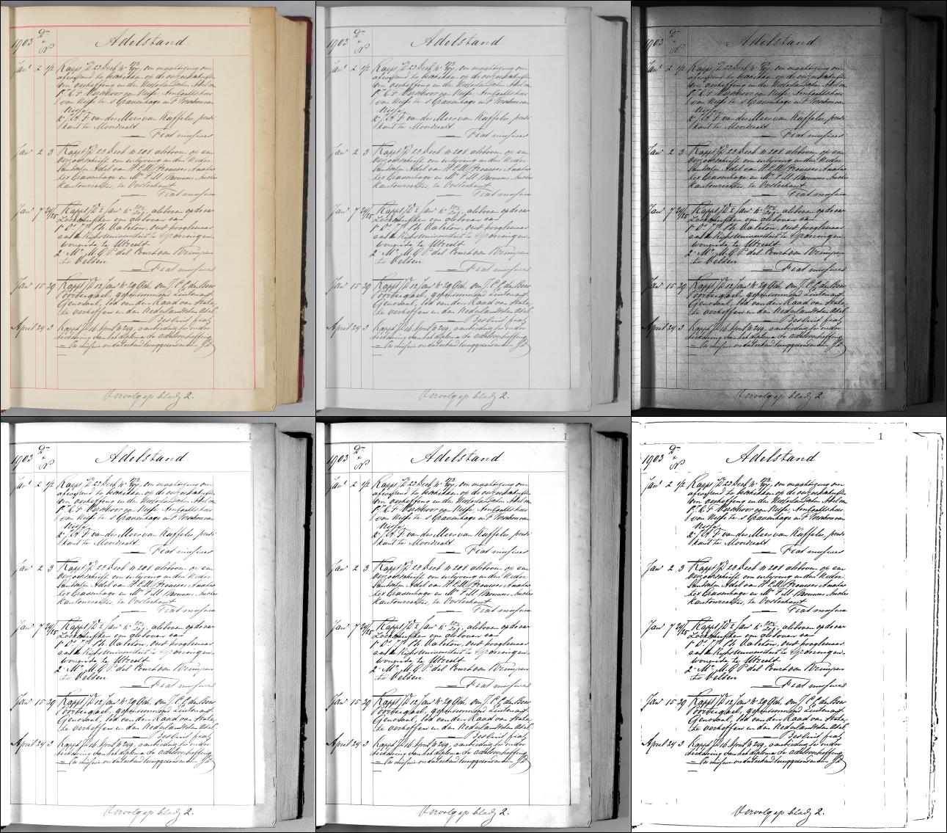
Gray histogram equalized
RGB
Gray
Gray Global contrast enhanced
Gray Local contrast enhanced
Bitonal B/W, dithered

Slide 33
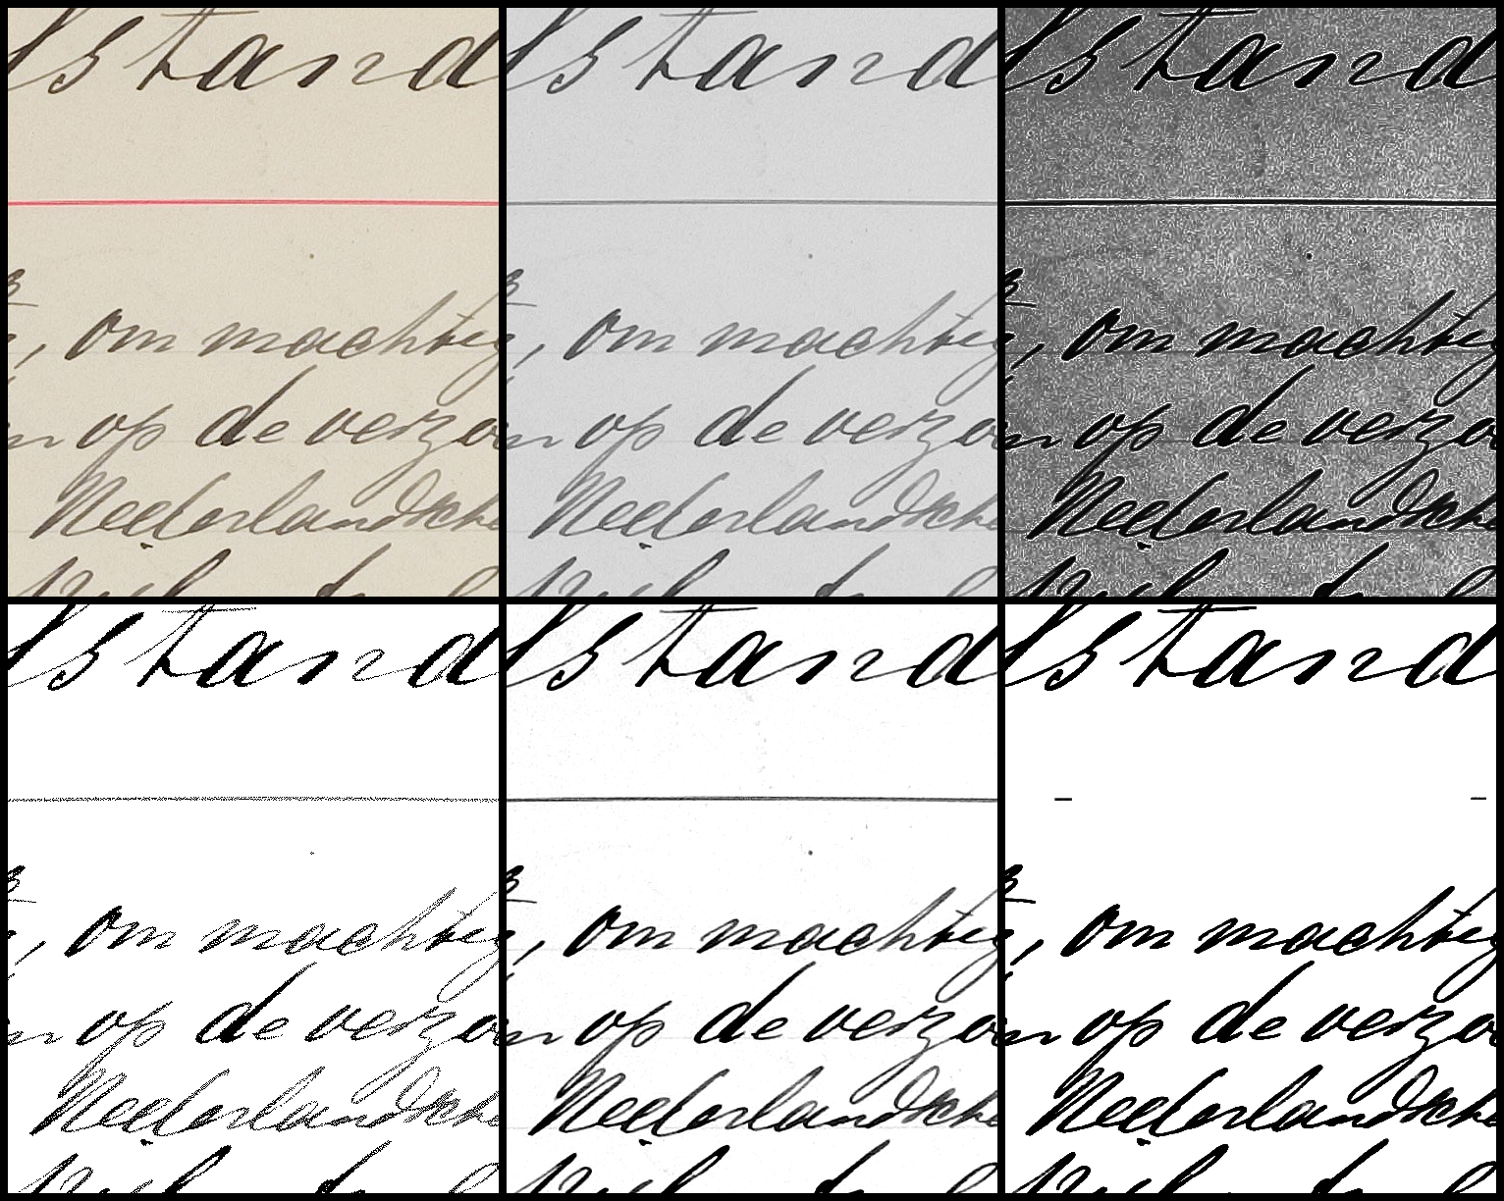

Slide 34
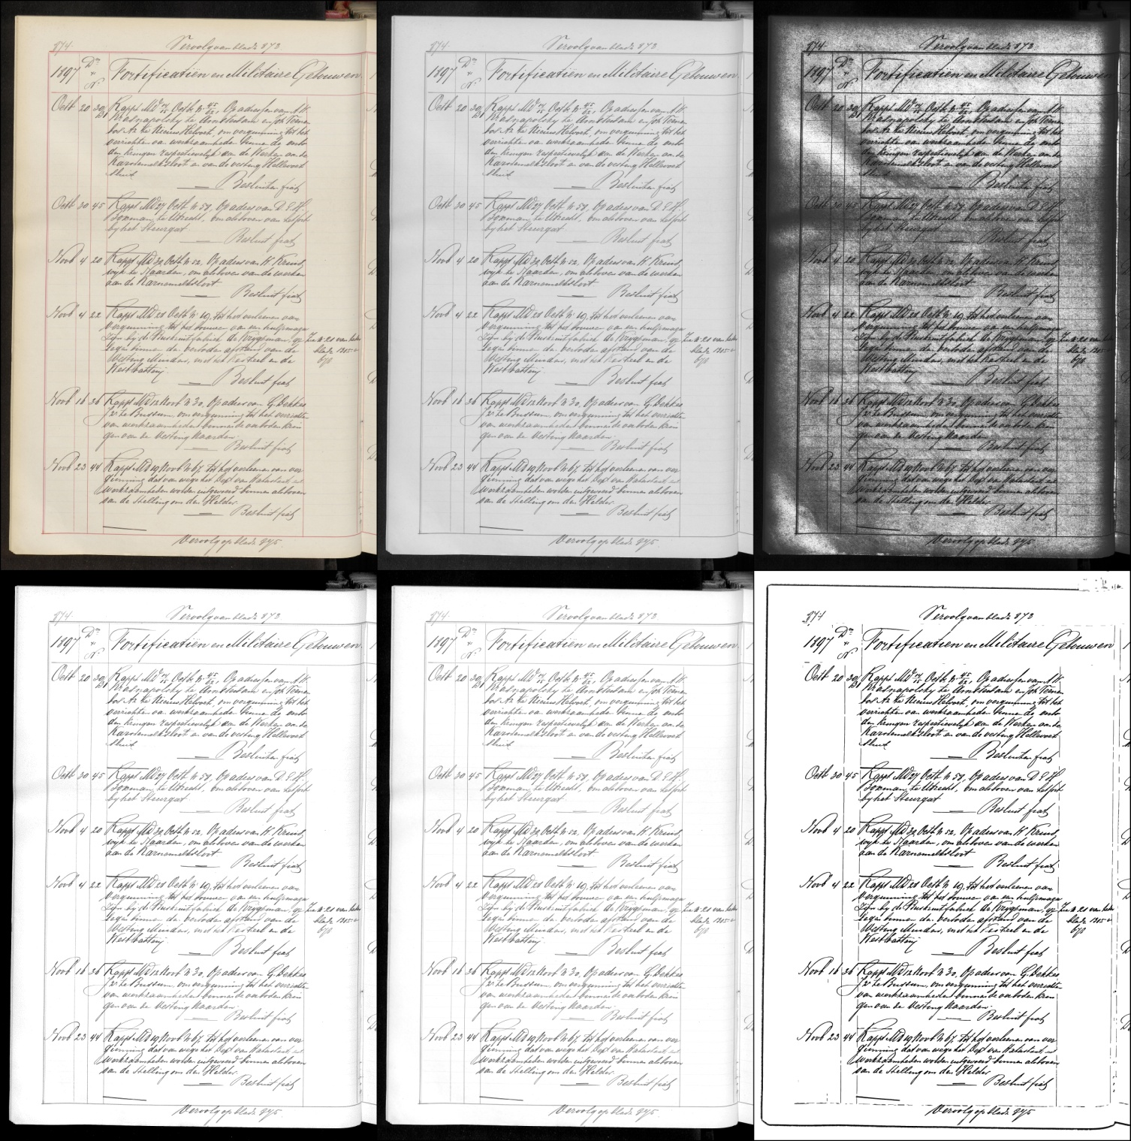

Slide 35
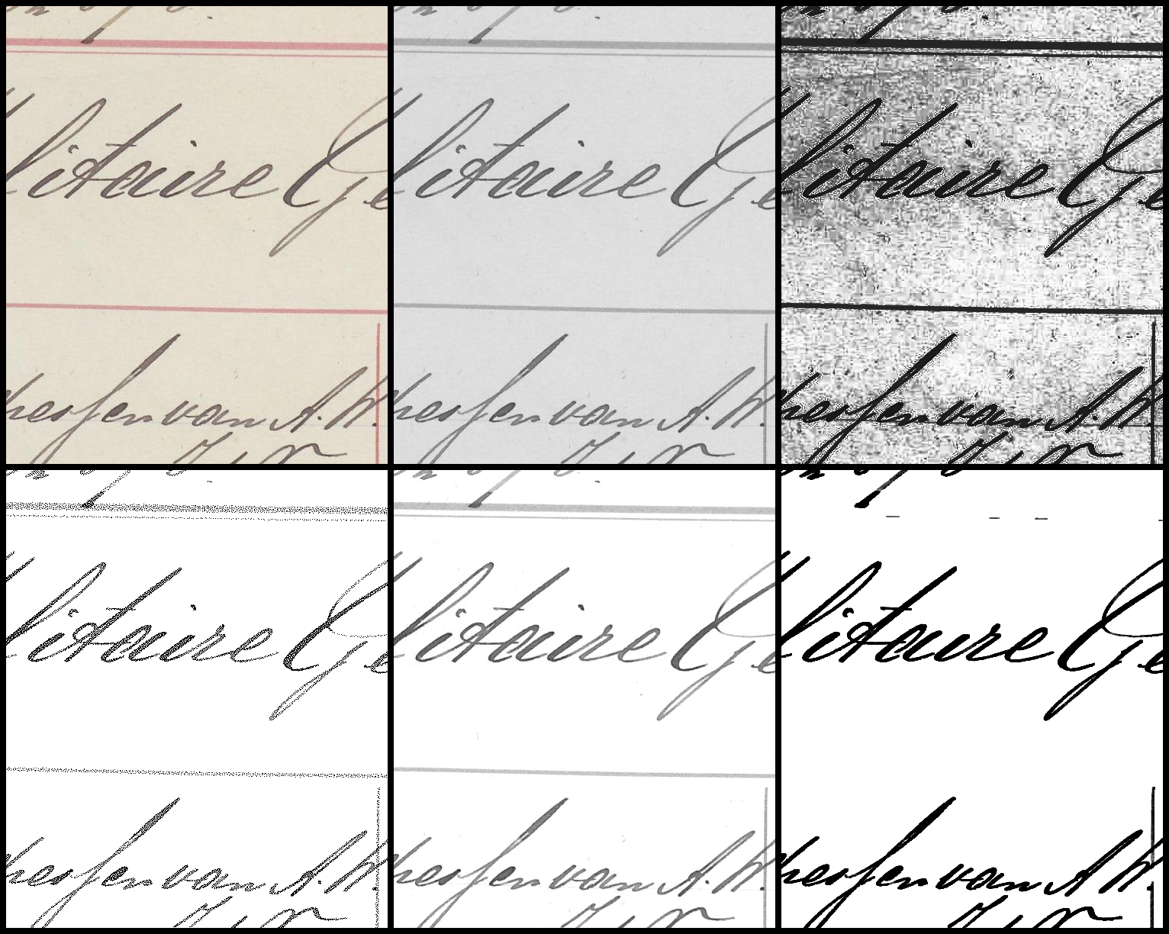

Slide 36
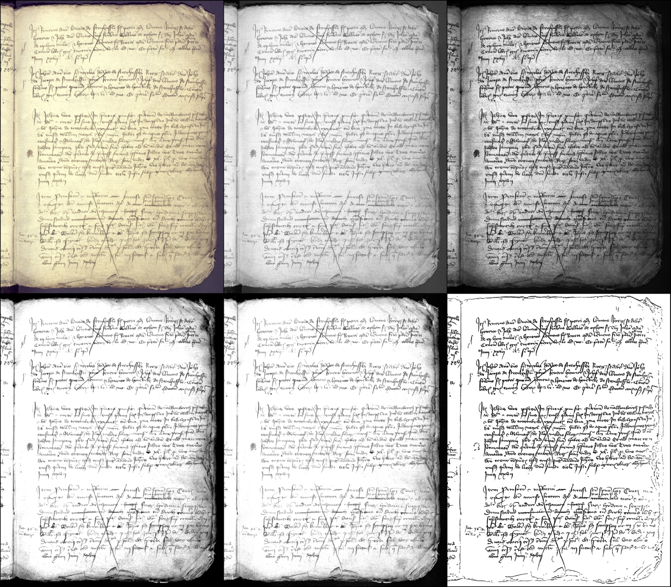
SAL 1421 Company C

Slide 37
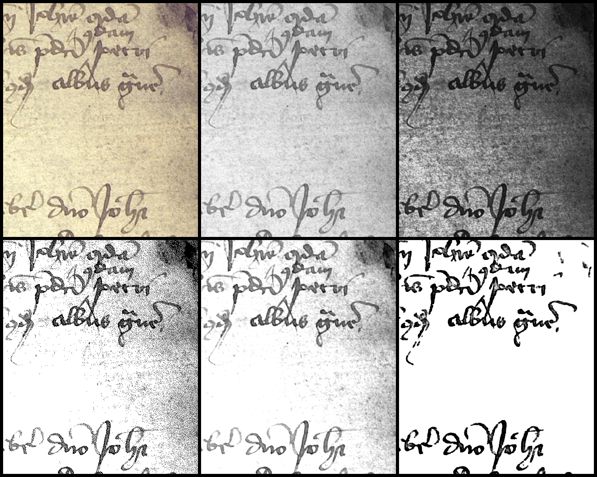
SAL 1421

Slide 38
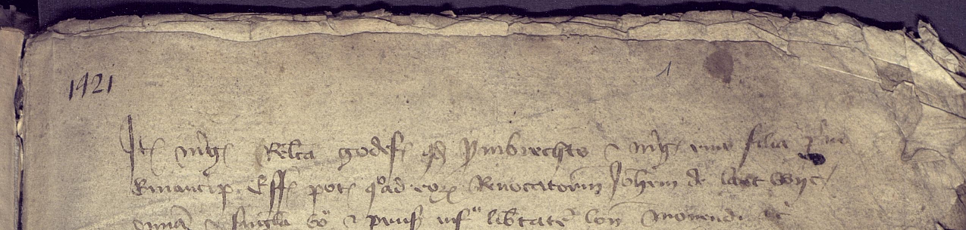
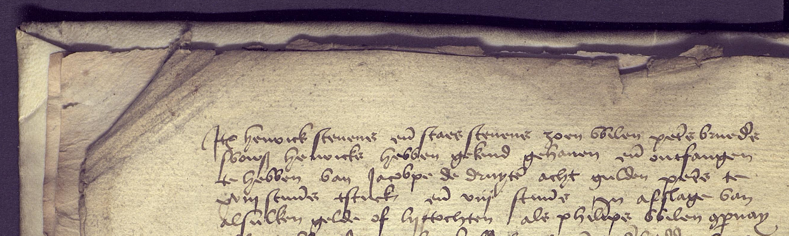
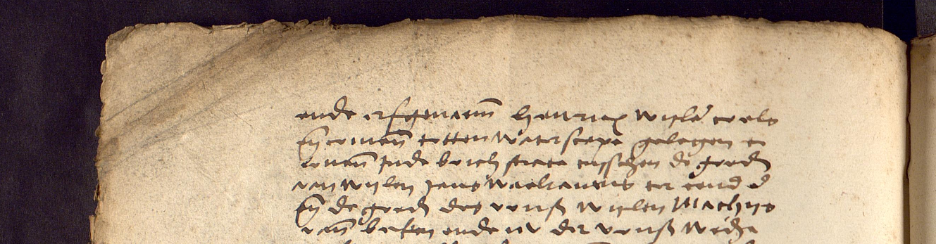
1421
1457
1559

Slide 39
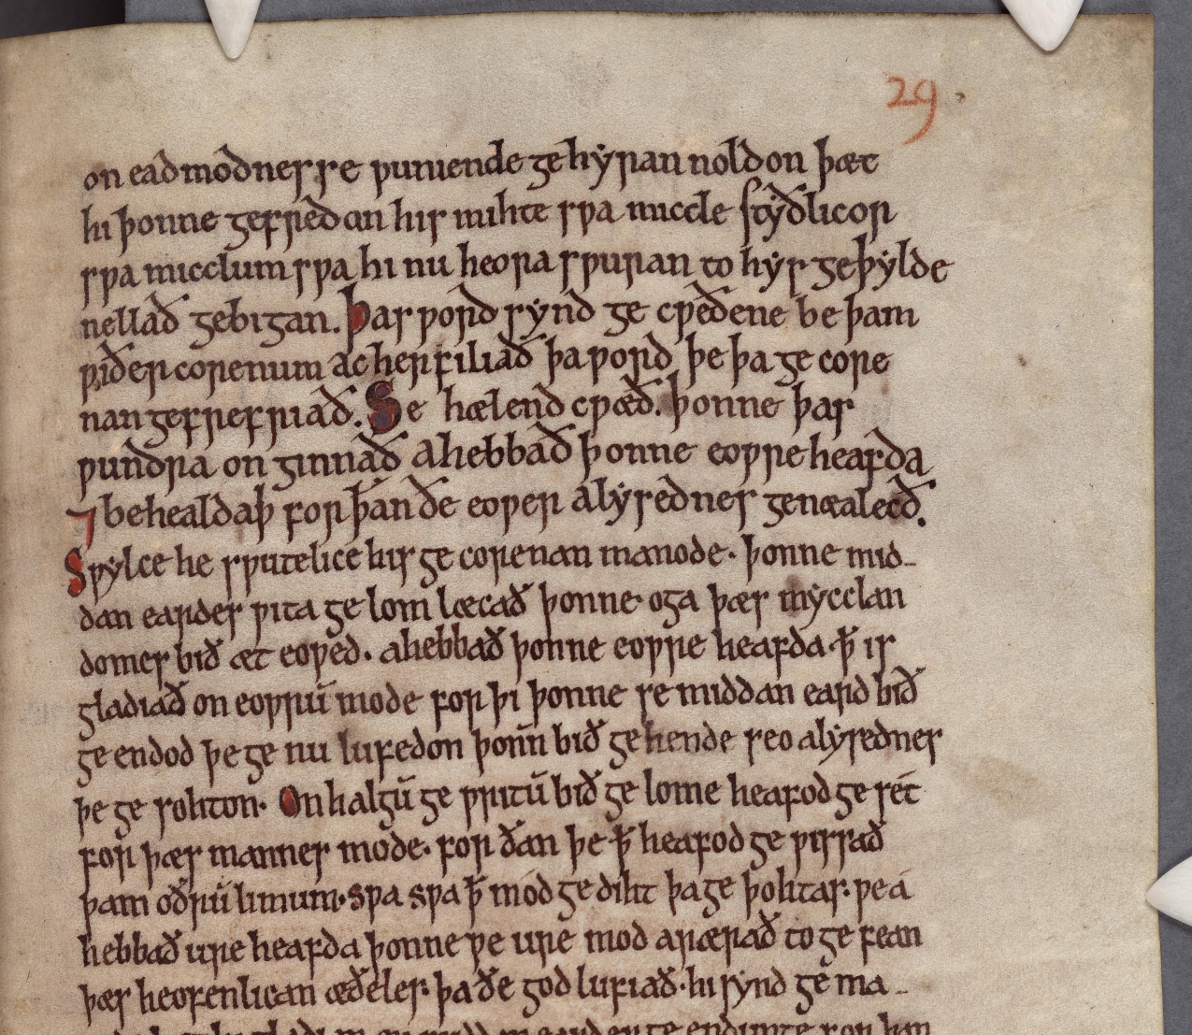
Beowulf
Elaine Treharne
Stanford

Slide 40
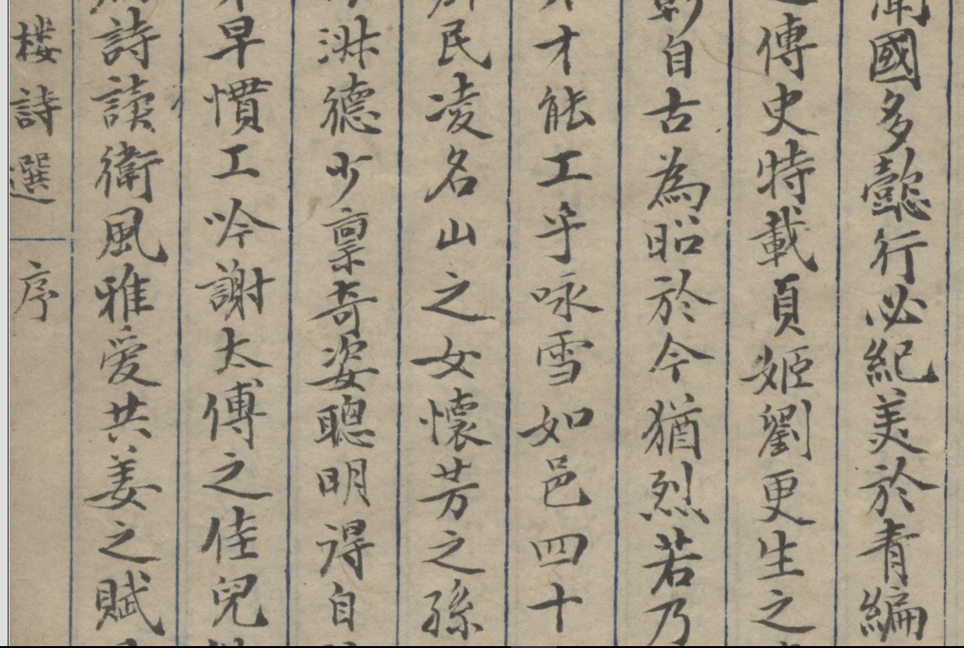

Slide 41
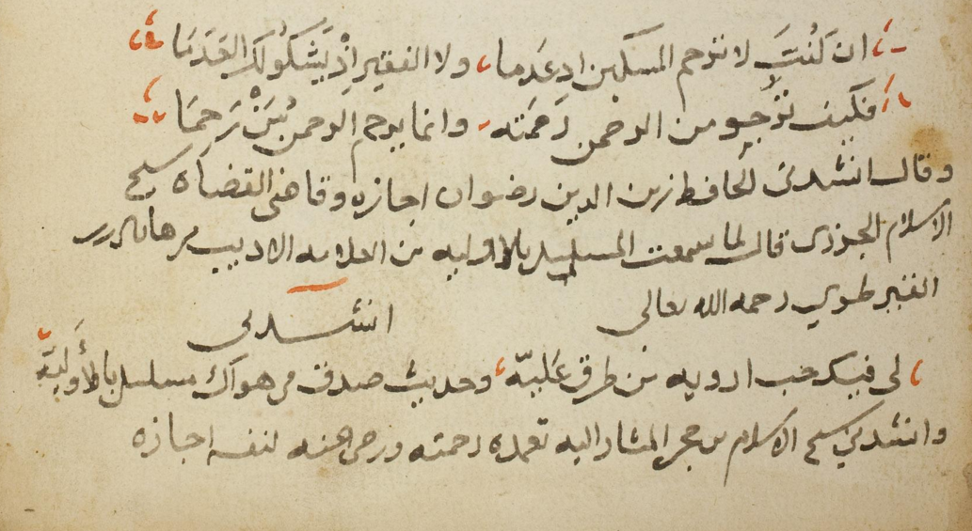

Slide 42
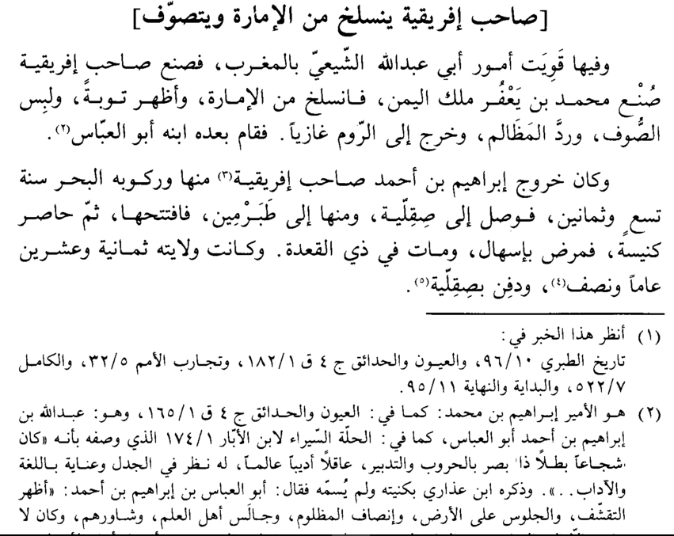

Slide 43
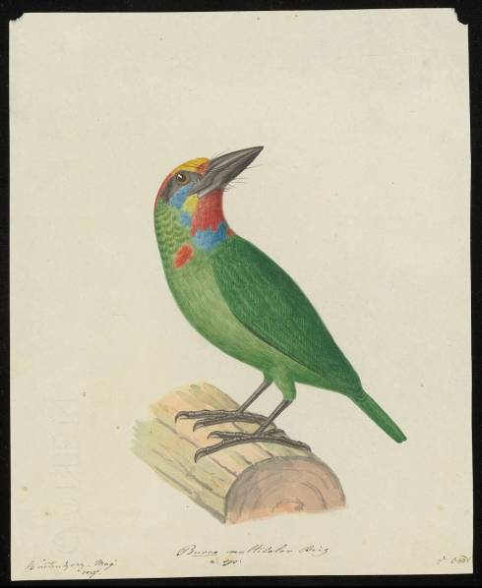

Geolocation and Date
Scientific name of species
Name of field scientist(=artist)
Fig. 4. Field drawing of a red-throated Barbet (Begalaima mystacophanos), Buitenzorg, Java, May 1827. Each field drawing contains place names, dates, scientific names and person names. The NC collections contains ca. 2000 of such field drawings.
NWO/ Making Sense project

Slide 44
Scanning and image preprocessing
‘Simple operations’ such as ink/paper separation are not at all solved fundamentally in image-processing science due to a pervasive ‘chicken and egg’ problem:
“In order to know the text, a system needs a good segmentation, but
a perfect segmentation into lines and words is only possible knowing the text “
Also systems that claim to be segmentation free must segment text into lines and deliver ‘blank’ codes for the word separations
Even systems that work with grey scale or color need to decide (yes/no) whether an object under focus is a real text item

Slide 45
Pattern recognition and machine learning
Several years of experimentation (online 3276 days)
started in 2005
Monk was switched on, to a largely autonomous mode, in 2009
For developing and optimizing two functions:
Retrieval: return images for a given keyword
Recognition: return the most likely word given an image

Slide 46
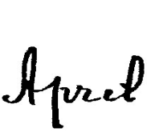
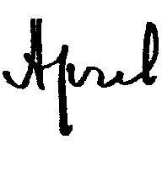
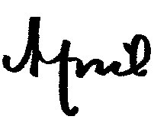





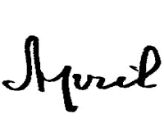
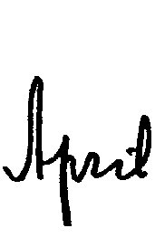
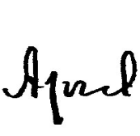
Retrieval of instances,
Shape Feature B rank_{j} (P(X_{j}|Model)
Recognition of classes,
Feature A
argmax_{i} (P(Model_{i}|X))
Rappt Aug April Amsterdam Besluit
Van Oosten & Schomaker (2013) Separability & Prototypicality … J. Pattern Recognition

Slide 47

Boosting performance
Old mine-shaft elevator principle: Fahrkunst
After having trained with method A to its ‘max’
An orthogonal method B can reach a higher performance
Then method A again, etc.
Until the real asymptote is reached
Method A – Method B

Slide 48
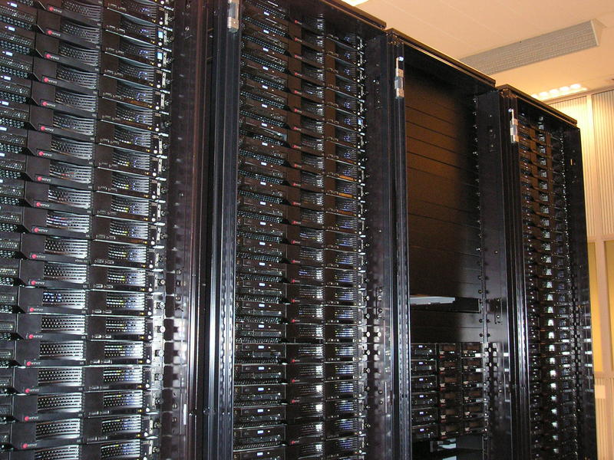
Model refinement
Hit list computation
Labeling by humans
THE SOLUTION: 24/7 learning over internet RuG HPC cluster
“Interactive Supercomputing”

Slide 50
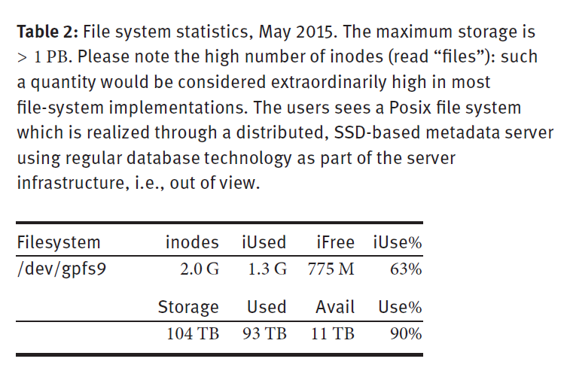
Schomaker, L. (2016). Design considerations for a large-scale image-based text search engine in historical manuscript collections, Information Technology. 59, ISSN: 2196-7032
Maximum number of files
Current number of files

Slide 51
Lessons learned during Monk development
A shape feature which is powerful for Retrieval may not be strong in Recognition!
Feature B: hit list should provide nice, intuitive ranking in a satisfying ‘hit list’
Feature A: target word class should survive competition with the other word classes (emerging needle from the heterogeneous hay stack)

Slide 52
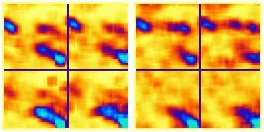
Examples of feature patterns for two words
van der Zant. Schomaker, Haak (2008). IEEE PAMI
Amsterdam Groningen

Slide 53
for nearest-neighbour matching

Slide 54
Current experiments in recognizers
HMM (hidden Markov models) - JP van Oosten
Deep learning/convolutional Schomaker/Wiering/Bhowmik/Dhali
BLSTM – M. Ameryan
Until now, none of the newer methods is better within Monk, but this may change. We have much more data today!

Slide 55
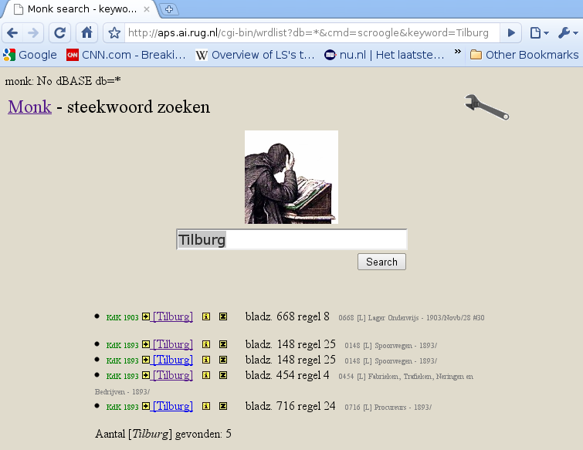

Slide 56
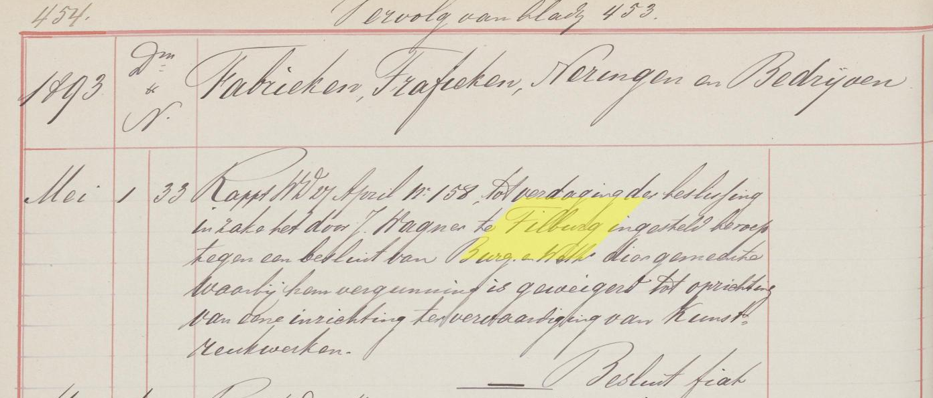
Tilburg:

Slide 57
Does it work? Questions from (candidate) users
Do you need to label continuously?
Then transcription would have been better/easier
How good is the pattern recognition?
Do you need a supercomputer?
How many people are working ‘back office’?
Can I send my collection to Monk?
What is the benefit, what is the output of the process?

Slide 58
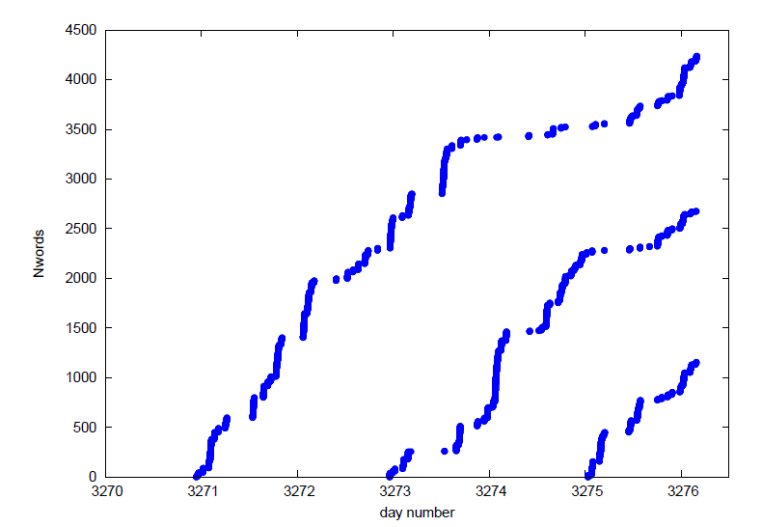
Label harvest: ‘HUMAN-confirmed’
Jumps in the number of harvested word labels (y-axis) coincide with reaching a critical training dataset size (time axis)
Note the stepwise ‘snowball effects’
New Naturalis collection, first three document sets, March 30 to April 6, 2016 (NWO/Making Sense project)

Slide 59
Performance
Retrieval precision increases monotonously with number of word examples
Lexicon of 11k words: > 81% recognition rate, KdK
Lexwords with 50+ examples: > 95% correct
Idem, Cliwoc captain’s logs: 93%
#training examples | What to expect in Top 50
1 | Correct instance is good luck
5 | A few correct hits
20 | Many useful hits

Slide 60
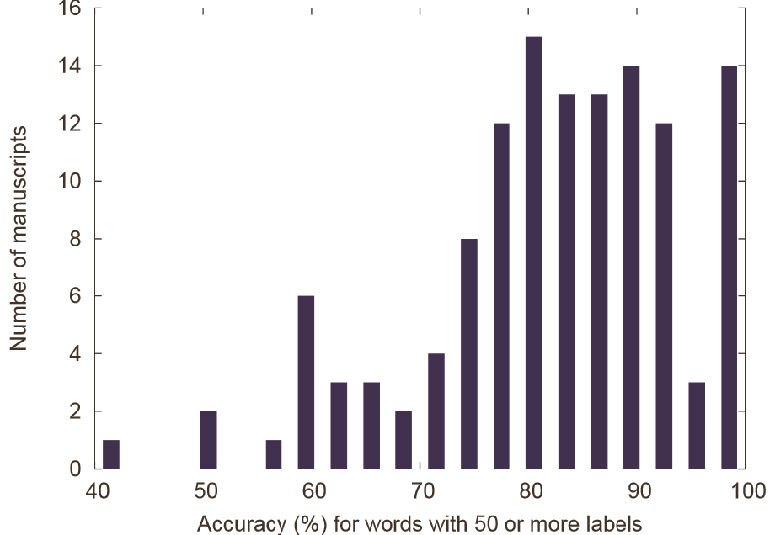
Performance
126 manuscripts
Train: 25 words/class
Test: 25 words/class
Additional labeling

Slide 61
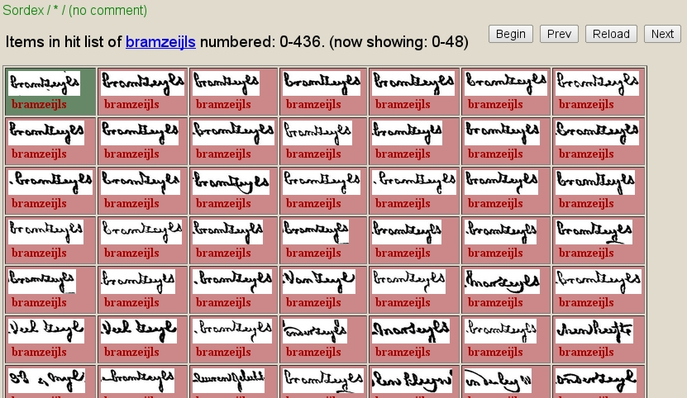
Good results: bramzeijls (top gallant’s) hit list after training on just 2 examples

Slide 62
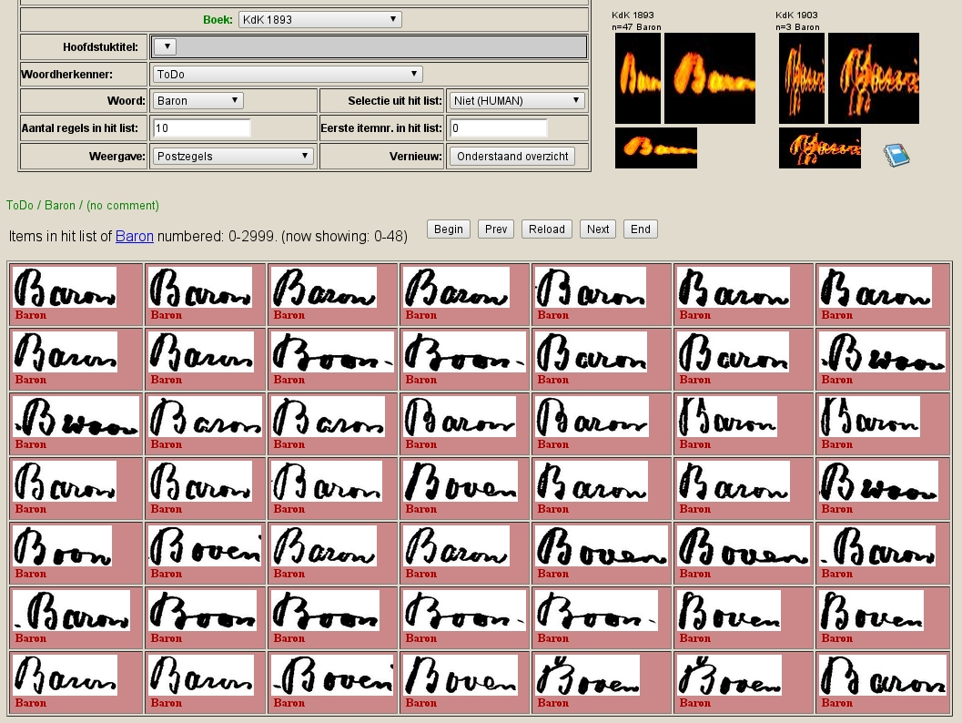

Slide 63
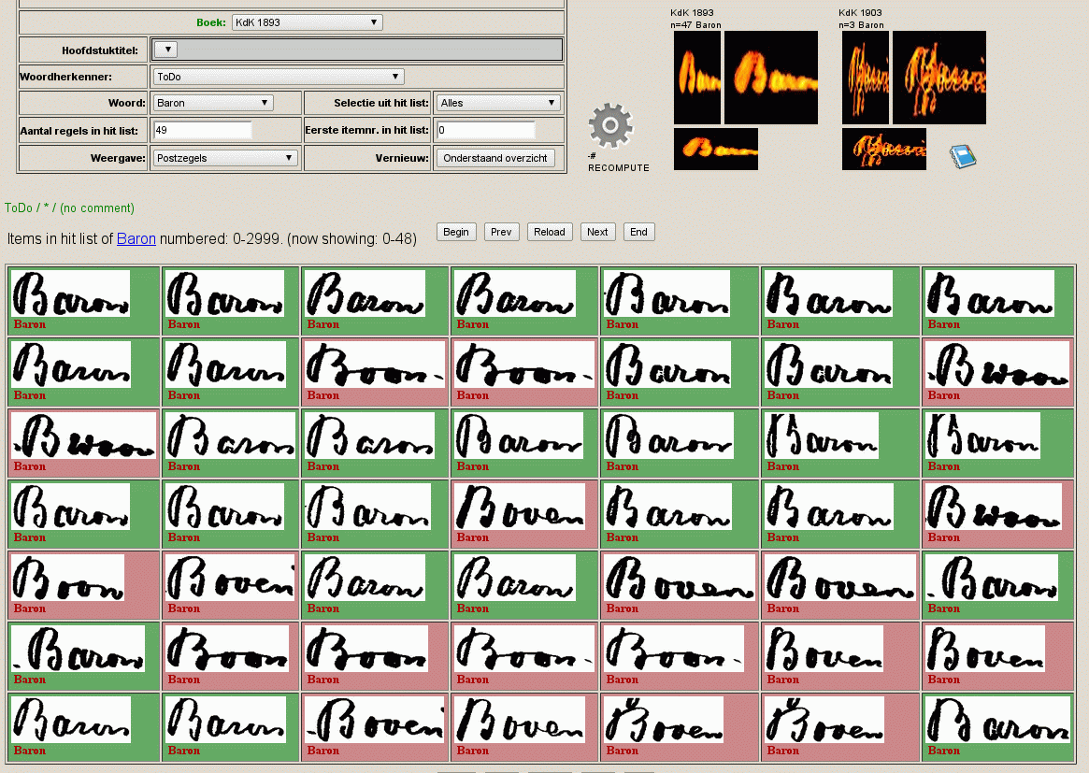

Slide 64
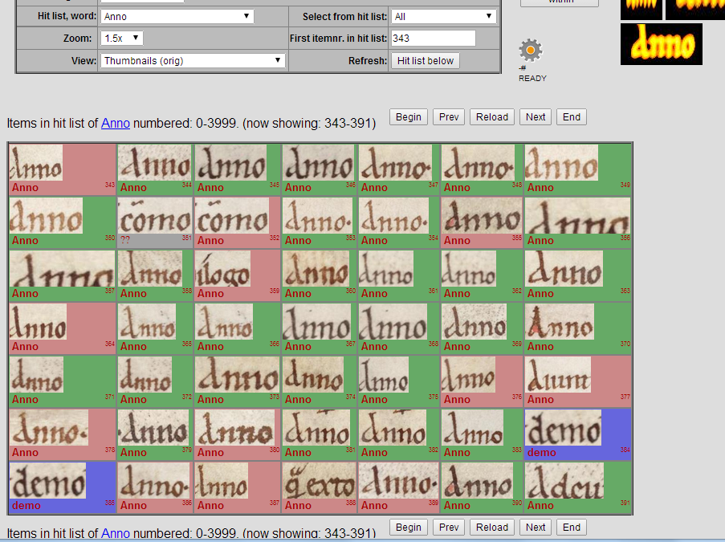
At rank 343 in the list: pink newlings

Slide 65
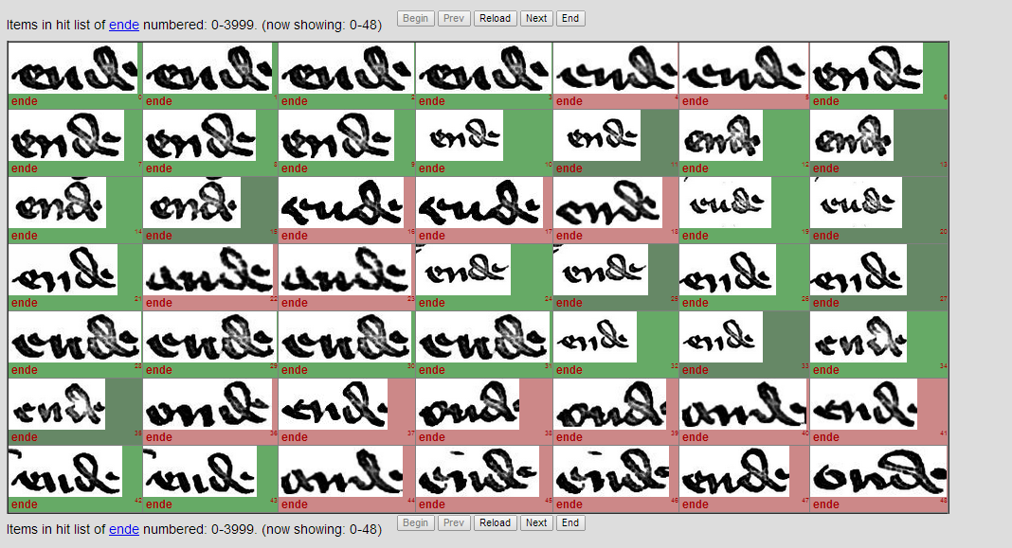

Slide 66
Monk usage example: May 2013 Qumran scrolls: Daniel Stoekl (Sorbonne), Mladen Popovics (Groningen)

Slide 67
Qumran scrolls: 2400 photographs
Using Monk for character labeling
With Daniel Stoekl and Mladen Popovics
Using its 24/7 machine-learning cycle:
Label ➔ Train ➔ Label some More ➔ Train ➔ Easily label Many
Thousands of characters ‘mined’ out of the Qumran collection of photographs in just two weeks, with very little effort in human labeling

Slide 68


Slide 69


Slide 70


Slide 71


Slide 72

Allograph harvest in Qumran collection

Slide 73

Allograph harvest 33k labels in NWO/MPS project with Huygens institute
… harvested during March 2014

Slide 74

Yes, also Chinese characters (handwritten & woodblock, Grace Fong & Harvard Yenchin collection)

Slide 75
Necessary metaphor for the Monk process
Not: a stream-lined mechanical factory
Yes: crystal-like growth, arborization,
Randomly over a large surface
Energy comes from:
human labels
machine re-compute actions

Slide 76


Slide 77


Slide 78


Slide 79

Static index example: Chronicon Boemorum (1201 AD, Cosmas)

Slide 80

Line transcriptions , actual (literal and text-rendered @Monk-codes)
Note: some @Monk-codes for word shapes have not been codified here, the user can click on them to do that

Slide 81

Line transcriptions , decontracted, literal and text-rendered @Monk-codes

Slide 82

Line transcriptions , word-by-word translation from Latin to Dutch

Slide 83

Monk’s Blue Book (xml): @Monk-code is a handle for several interpretations or (unicode) renderings. We will also implement MUFI here.
Medieval Unicode Font Initiative

Slide 84

provisional transcriptions. The text shown comes either from human line transcription or (human) confirmed recognized words (see …)

Slide 85
How to improve on human and machine transcriptions?
The legal transactions in the acts of the Leuven Alderman’s rolls, 1421: Towards a formal semantic model of acts (Marianne Ritsema van Eck, august 2011). ➔ experts fight over the transcription ➔ students need to know more than paleography ➔ the machine needs a model for top-down reasoning
Presented at Digital Humanities 2012

Slide 86

Semantic modeling and layout of acts: example: ‘IOU’

Slide 87

Spatial modeling: Layout vs Semantics in the acts of the Schepenbank

Slide 88



Annotation / transcription formats
TEI: aimed at transcription, limited functionality for layout specification
(TruViz, GEDI, Alto) ➔ ‘PAGE’ standards for layout specification limited functionality for transcription/transliteration and encoding
(x,y)
h
w
Rectangular ROI

Slide 89
Annotation / transcription formats
TEI: aimed at transcription, limited functionality for layout specification
(TruViz, GEDI, Alto) ➔ ‘PAGE’ standards for layout specification limited functionality for transcription/transliteration and encoding (Pletschacher, 2010)
(x₁,y₁, x₂,y₂, …, x_{n},y_{n})
Polygonal ROI

Slide 90

Digging into Data / Global currents -- US/Canada/NL project with Mohamed Cheriet of Ecole de technologie supérieure(Montréal) Andrew Piper (McGill University) (principal investigator) Elaine Treharne (Stanford University)

Slide 91

Digging into Data / Global currents -- US/Canada/NL project with Mohamed Cheriet of Ecole de technologie supérieure(Montréal) Andrew Piper (McGill University) (principal investigator) Elaine Treharne (Stanford University)

Slide 92
Conclusions
Great progress is made in handwritten text retrieval in recent years
The concept of iterative refinement by human labeling & computing really works ➔ interactive machine learning over Internet
Image preprocession and layout analysis are important, still crude and not fundamentally solved
Image-quality standards (NL norm: Metamorfoze) do not guarantee high-performance handwritten text recognition
New methods are continuously being developed at all processing levels from image to semantics
Think big!

Slide 93


Slide 94


Slide 95


Slide 96


Slide 97


